Slide 1
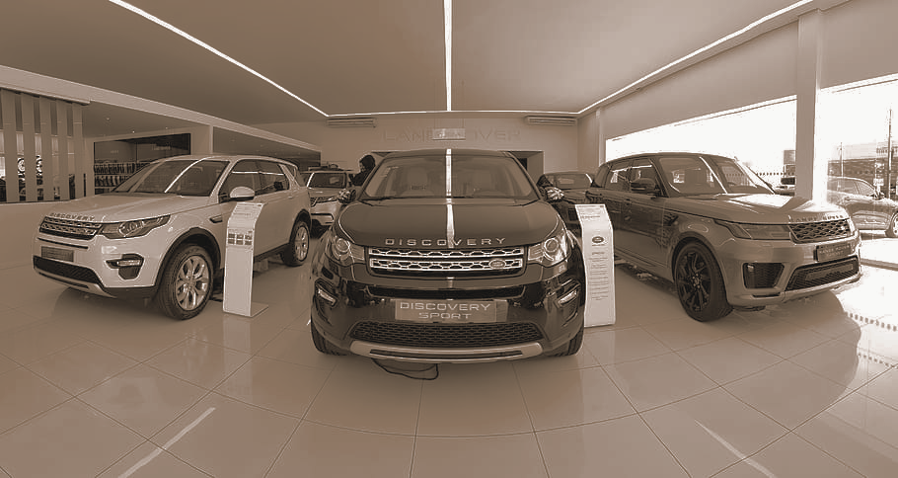
Car Price Prediction Using Multiple Linear Regression
This presentation outlines a project to develop a model using multiple linear regression to predict the market value of cars based on various factors such as make, model, year, mileage, and other features.
Presenting Team: Muskan, Anusha, Khantil, Mohan & Deepesh

Slide 2

Introduction
The automobile industry is a highly competitive and dynamic industry, with various factors influencing the price of a car. Accurately predicting car prices can assist customers in making informed decisions while also helping businesses in pricing their products effectively. The aim of this project is to predict the prices of cars using multiple linear regression. The dataset for this project is sourced from Kaggle, consisting of information on various cars.

Slide 3
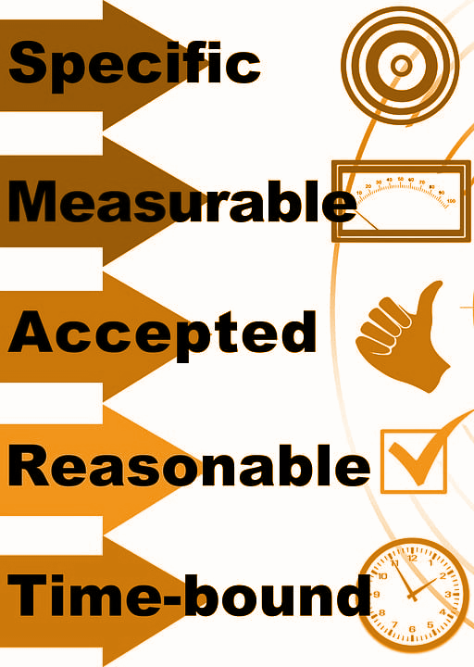
Data & Business Objective
The pricing of cars in the American market is affected by several factors. Here are some of the significant variables that can help in predicting the price of a car:
Brand: The brand of a car plays a significant role in its pricing. Established brands with a good reputation and customer loyalty tend to have higher prices than newer or less popular brands.
Vehicle size and type: The size and type of a car, such as sedan, SUV, sports car, or truck, also impact its price. Larger and more luxurious vehicles tend to have higher prices than smaller or less equipped models.
Engine type and power: The type of engine, such as gasoline or electric, and its power output also affect the price of a car. More powerful engines and advanced technologies such as hybrid or electric powertrains can increase the cost of the vehicle.
Features and options: Additional features and options such as leather seats, sunroofs, infotainment systems, and safety features can increase the price of a car.
Production and labor costs: The cost of manufacturing, shipping, and marketing a car also affect its price. Local manufacturing and supply chain efficiencies can lower production costs, which can then be reflected in the price.

Slide 4

Expected Outcome
To determine how well these variables describe the price of a car, we can conduct statistical analysis, such as regression analysis, to identify the relationships between these variables and the car's price. The analysis can help determine the relative importance of each variable and how much of the variance in price can be explained by these variables. The result of this analysis can help develop a pricing strategy that is competitive and tailored to the American market.

Slide 5

Understanding Dataset
The dataset used in this project contains information about 24 UNIQUE cars, including their make, model, year, mileage, fuel type, engine size, and other features, as well as their market value.
The dataset was obtained from a publicly available source and was cleaned by removing any missing values and outliers.
The need is to understand the factors affecting the pricing of cars in the American Market since those may vary from other market.
Which variables are important in predicting the price of the car?
How well can those variables describe the price of car?

Slide 6

Data Exploration
Libraries used:
Pandas
Numpy
Matplotlib
Seaborn
Sklearn
statsmodel
Analysis done using Python.
Descriptive statistics, a correlation analysis, and visualizations were used to explore the dataset.
Summary statistics were used for numerical variables such as mean, median, standard deviation, and range.
Histograms, scatter plots, and box plots were used to visualize the distribution of the numerical variables and their relationship with the target variable.

Slide 7
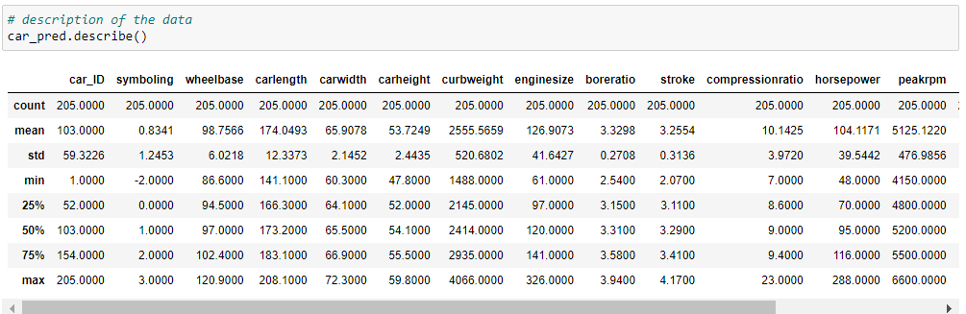
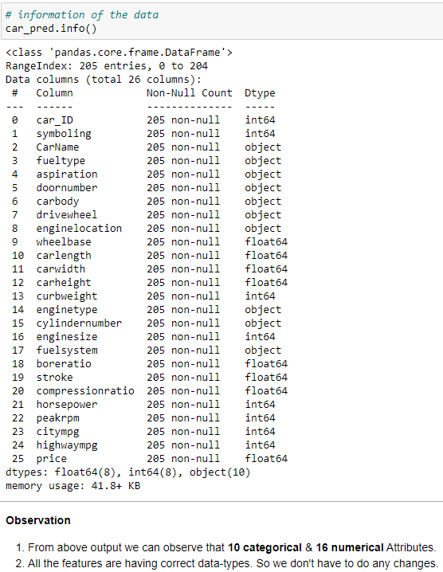
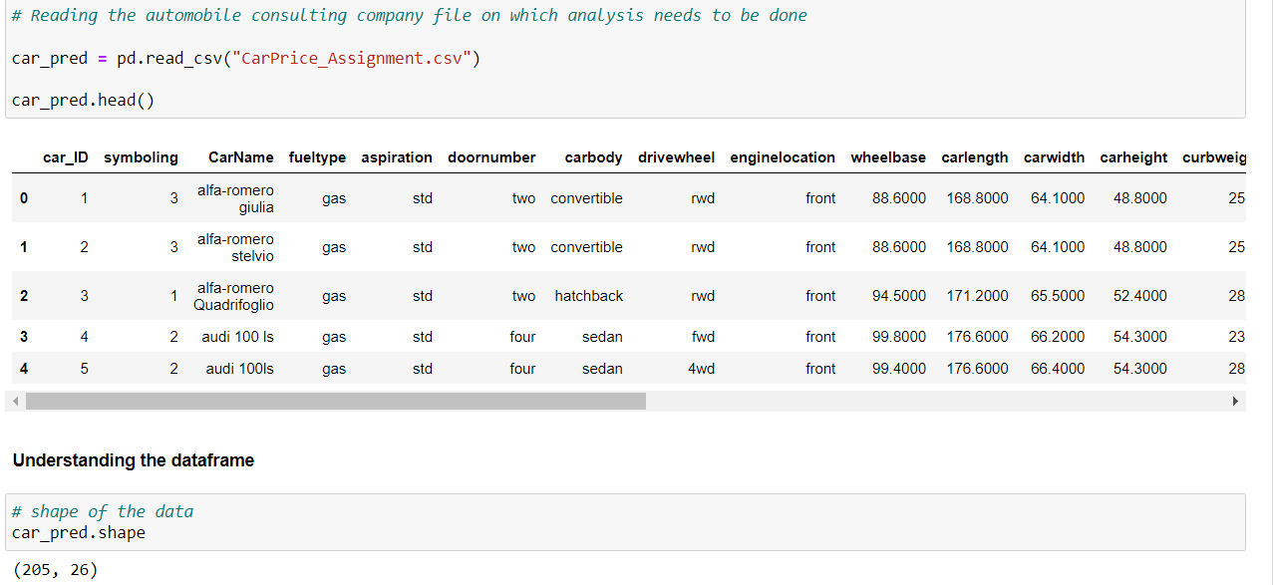
Data Exploration and understanding Categorical and Numerical attributes.

Slide 8
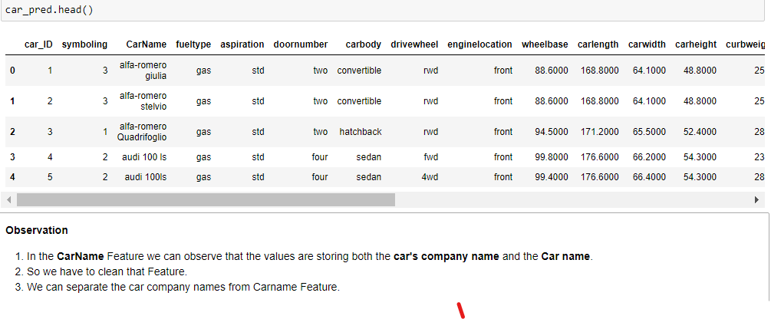
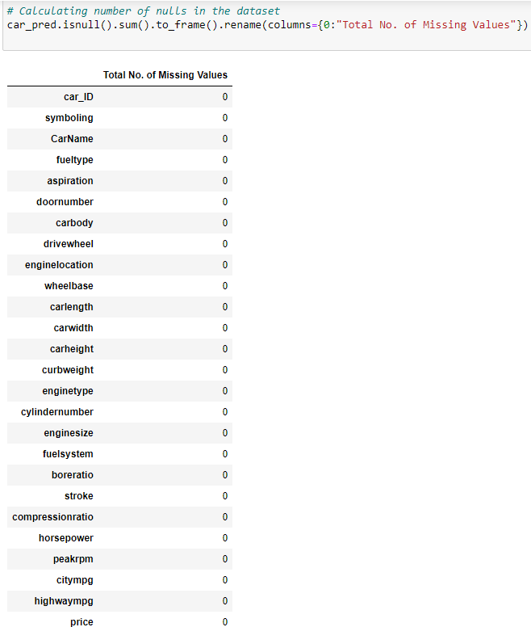
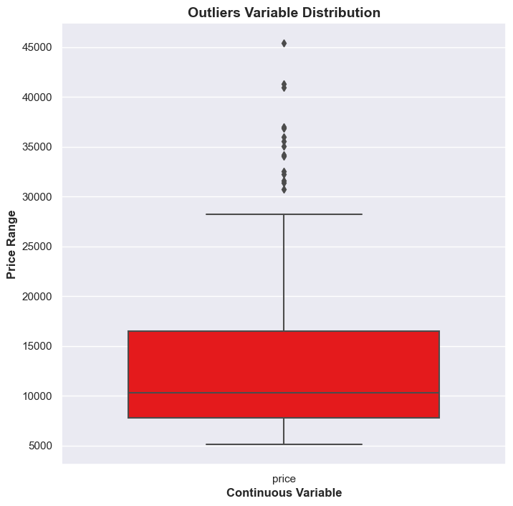
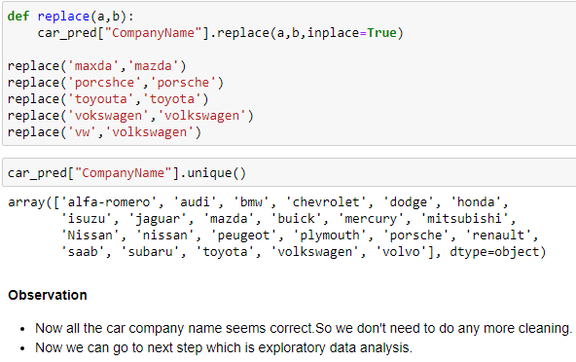
We can observe that none of the features is having Missing values.
Data Cleaning
There are some price ranges above 36000 which can be termed as outliers but lets not remove it rather we will use standardization scaling.

Slide 9
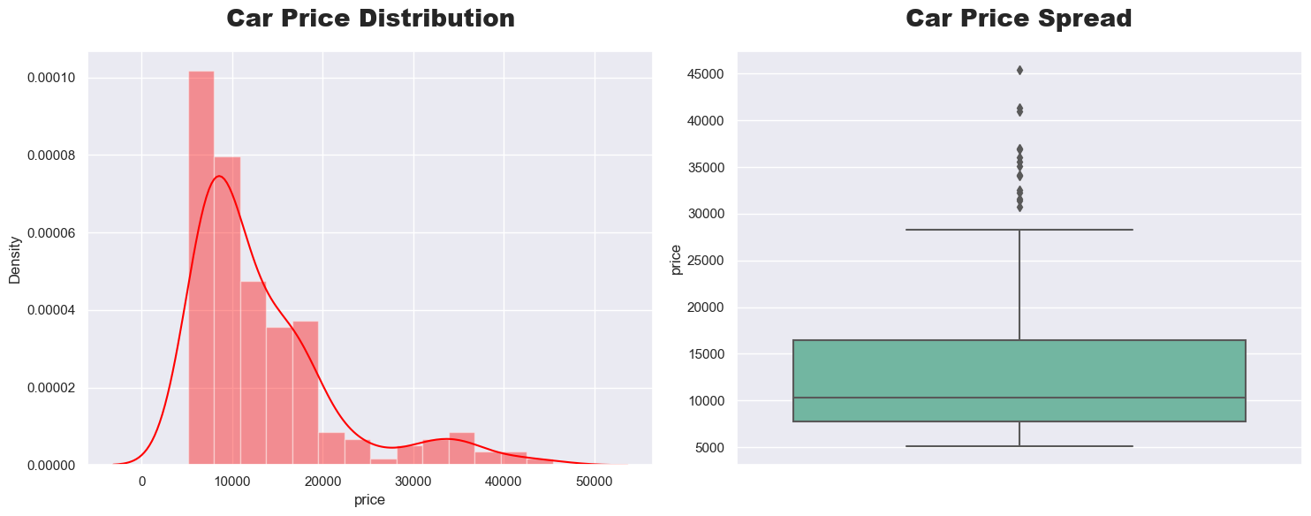
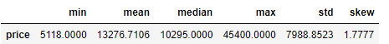
Visualizing Target Feature
Insights
We can clearly observe that Car Price Feature is Right Skewed.
We can clearly observe that there is a significant difference between mean & median value.
We can also make an insight that most of the car's price is below 14000.
We can also that the skewness of the car price is above 1.5 which means that the data points are highly spread.

Slide 10
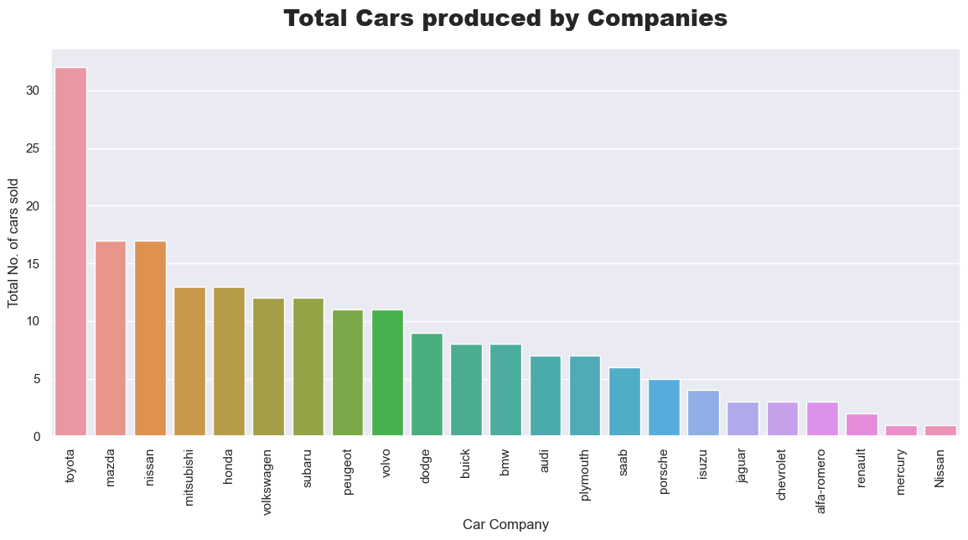
Visualizing Total No. of cars sold by different company
Insights
Toyota company has sold the highest number of cars.
So we can say that Toyota is kind of customers most favoured company.
Nissan, Mercury and Renault are having very low data-points. So we can't make any inference of least sold car companies.

Slide 11
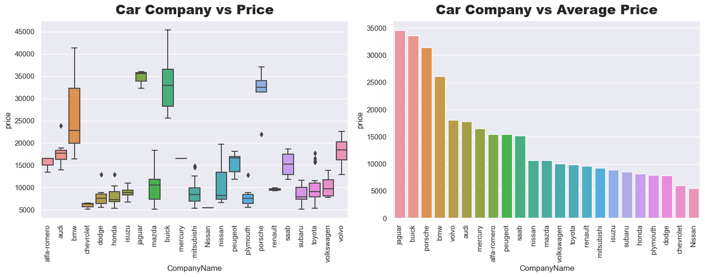
Visualizing Car Company w.r.t Price
Insights
Jaguar & Buick seems to have the highest price range cars.
Car companies like Nissan,Renault & Mercury are having only one to two data points.
So we can't make any inference related to lowest price range car companies.
Note: Since there are too many categories in car company feature. So we can derive a new feature Company Price Range which will show the price range as Low Range, Medium Range, High Range.

Slide 12
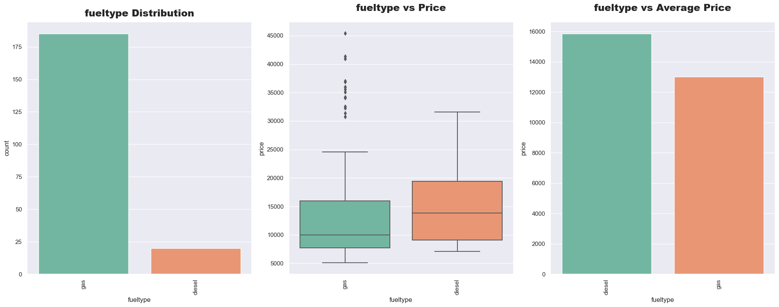
Visualizing Car Fuel Type Feature
Insights
Cars having gas fuel system is mostly sold.
From the second plot we can infer that Gas Fuel System cars are available within every price range.
From the third plot we can make an see that the Average price of gas fuel type cars are less than diesel fuel type cars.

Slide 13
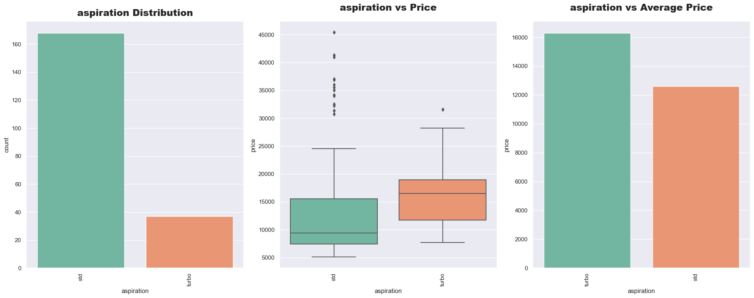
Visualizing Aspiration Feature
Observation
STD (Standard) cars are highly sold as compared to Turbo.
As aspirations are higher Turbo, they are priced higher in range as compared to STD.
Insights
Outliers present in STD Aspiration states that some of the cars having STD aspiration are expensive too.

Slide 14
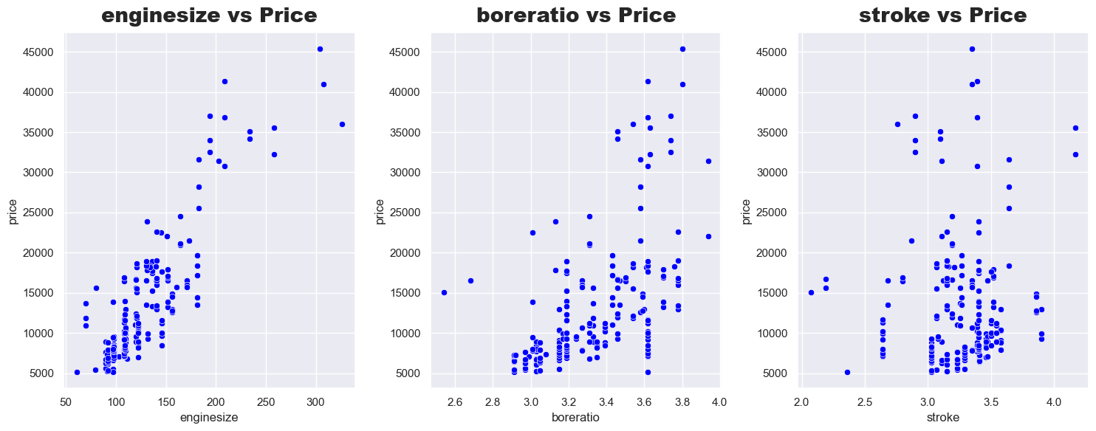
Visualizing "EngineSize","Boreratio" & "Stroke" Features
Insights
Engine Size is highly correlated with price feature.
Bore Ratio vs Price we can observe that the feature is not highly correlated but still there's a correlation between the features.
From Stroke vs Price we can't make any inference as the data-points are too scattered.
Since Stroke is not affecting Price that much. We can drop this feature.

Slide 15
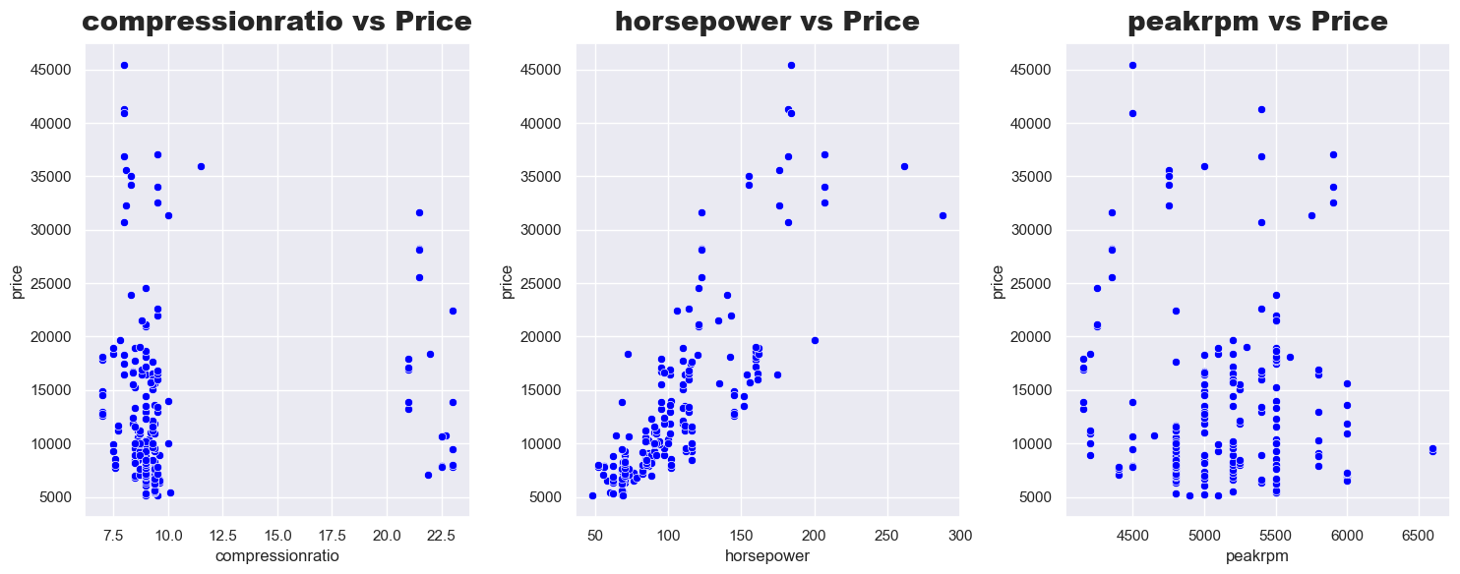
Visualizing "Compression Ratio","Horsepower" & "Peak Rpm" Features.
Insights
Horsepower is highly correlated with Price. So we can say with the change in Horsepower the price of cars also changes.
Compression Ratio vs Price & Peak Rpm vs Price we can't make any inference as the data-points are too scattered.
Compression Ratio & Peak Rpm is not affecting price. So we can drop this features.

Slide 16
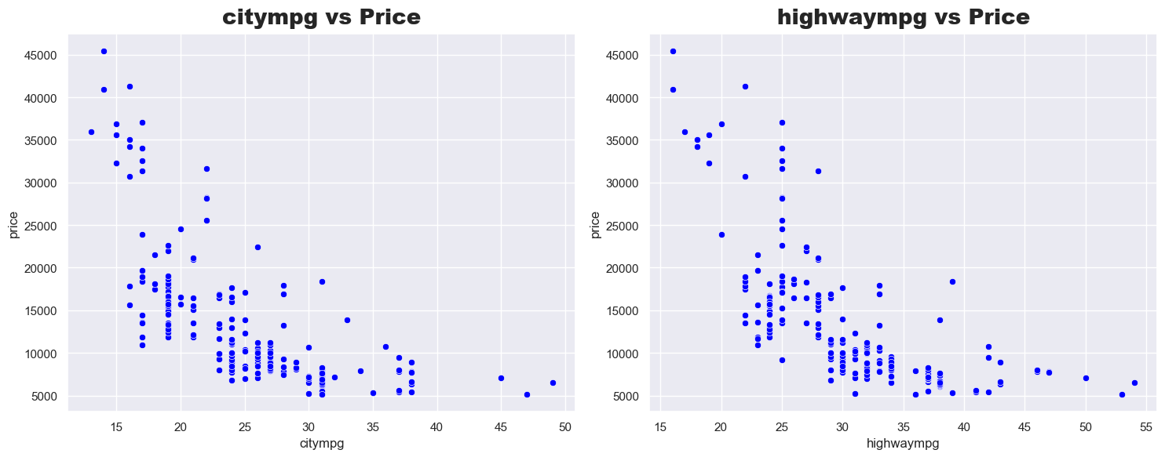
Visualizing "City Mpg" & "Highway Mpg" Features
Insights
City Mpg & Highway Mpg are having strong correlation with the price.
With higher priced cars the city mpg and highway mpg is lower while with lower priced cars the city mpg and highway mpg is higher.
So our both City Mpg & Highway Mpg are useful features for price prediction.

Slide 17
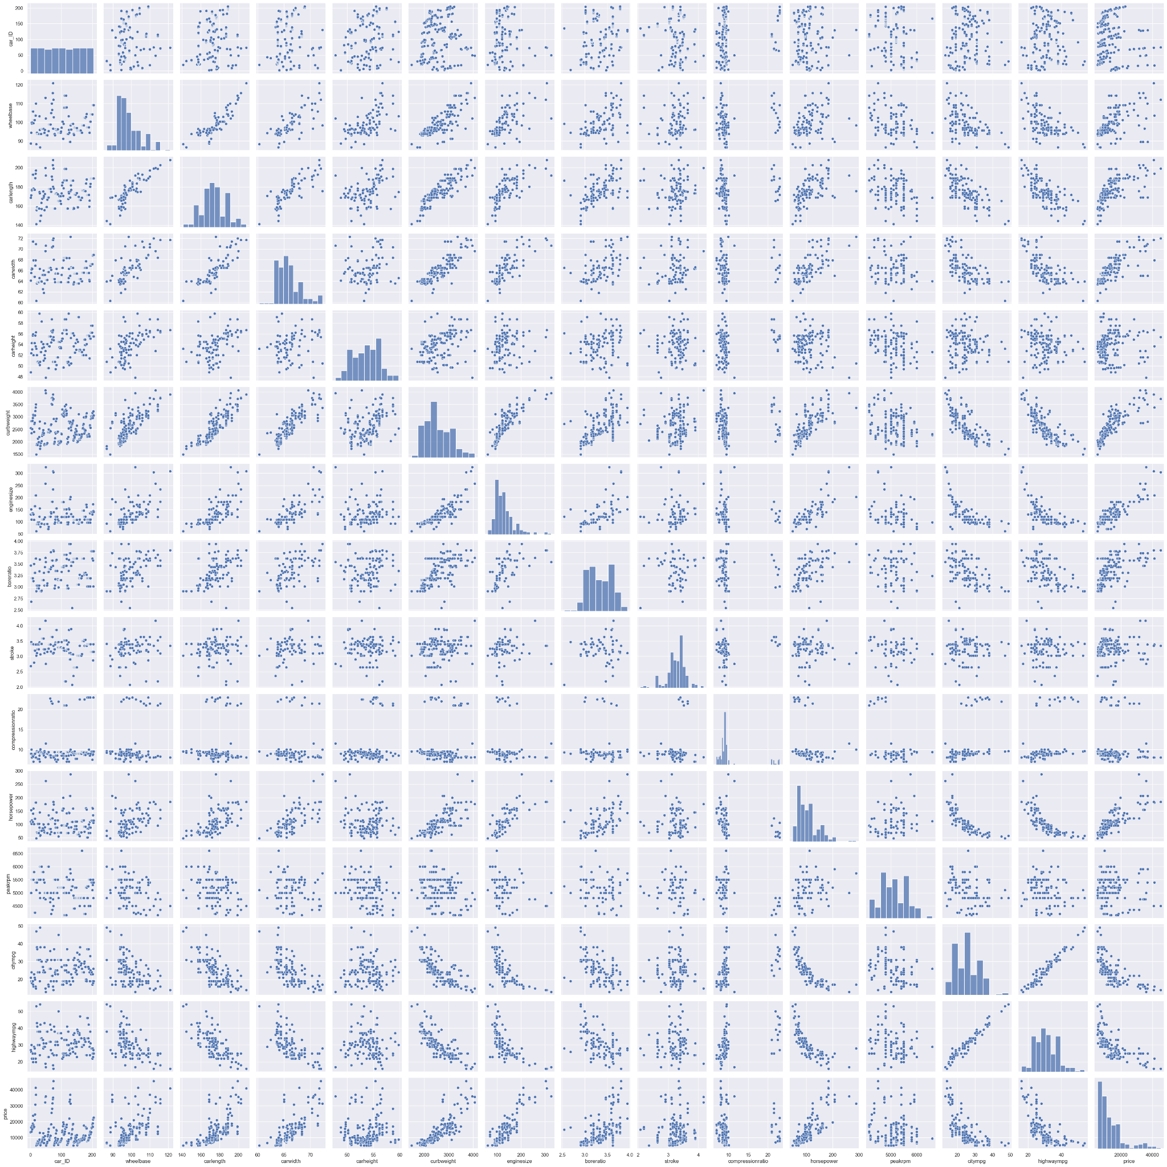
Visualising Numeric Variables
Insights:
car width, carlength, curb weight, enginesize, horsepower seems to have a positive correlation with price.
carheight doesn't show any significant trend with price.
city mpg, highway mpg - seem to have a significant correlation with price

Slide 18

List of all the useful Features using the EDA
List of all the useful Categorical Features.
Company Name
Fuel Type
Aspiration
Door Number
Car Body
Drive Wheel
Engine Type
Cylinder Number
Fuel System
List of all the useful Numerical Features.
Wheelbase
Carlength
Car Width
Curb Weight
Enginesize
Boreratio
Horsepower
city mpg
Highway Mpg
Price

Slide 19
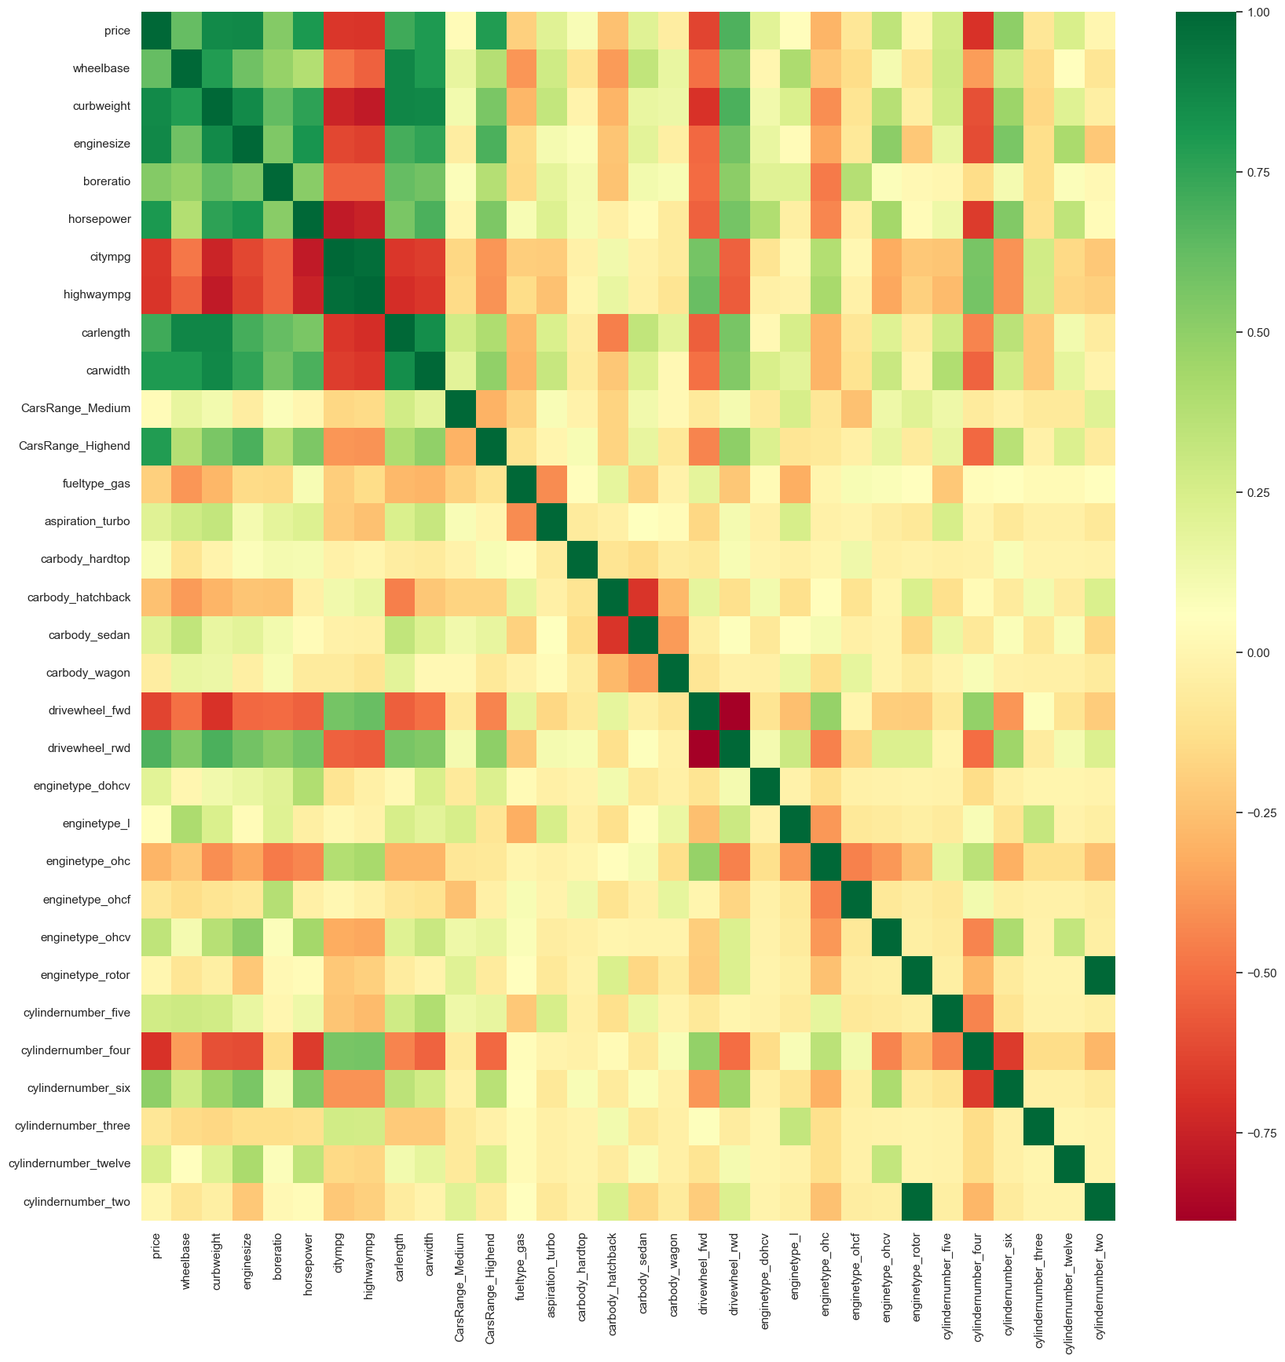
Data Engineering
Dummy Variables
Splitting data in Train and Test sets
Rescaling features using
Min-Max scaling
Standardisation (mean-0, sigma-1)

Slide 20
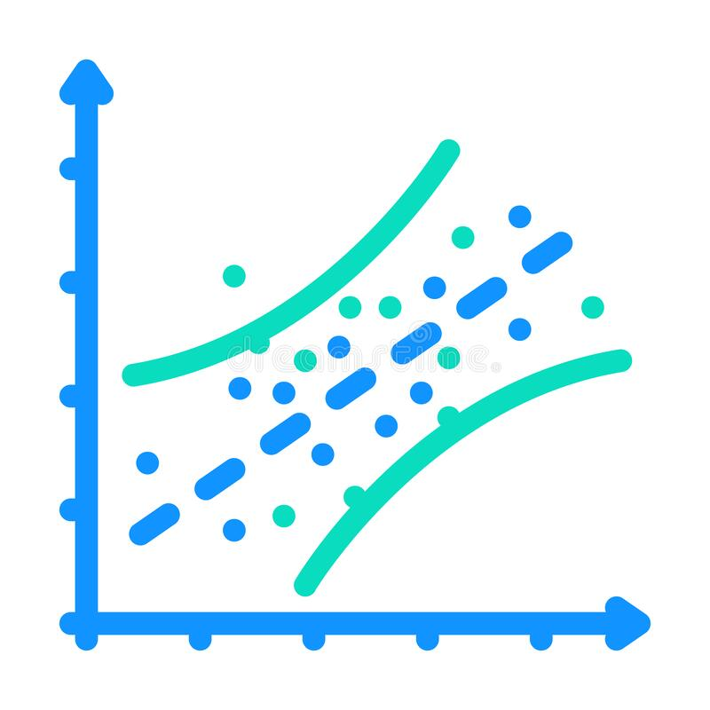
Model Building
Feature selection was used to select the most relevant independent variables for the model using techniques such as forward selection, backward elimination, or stepwise regression.
A multiple linear regression model was fitted to the selected independent variables and the dependent variable (market value).
Model evaluation was carried out using metrics such as R-squared, adjusted R-squared.

Slide 21
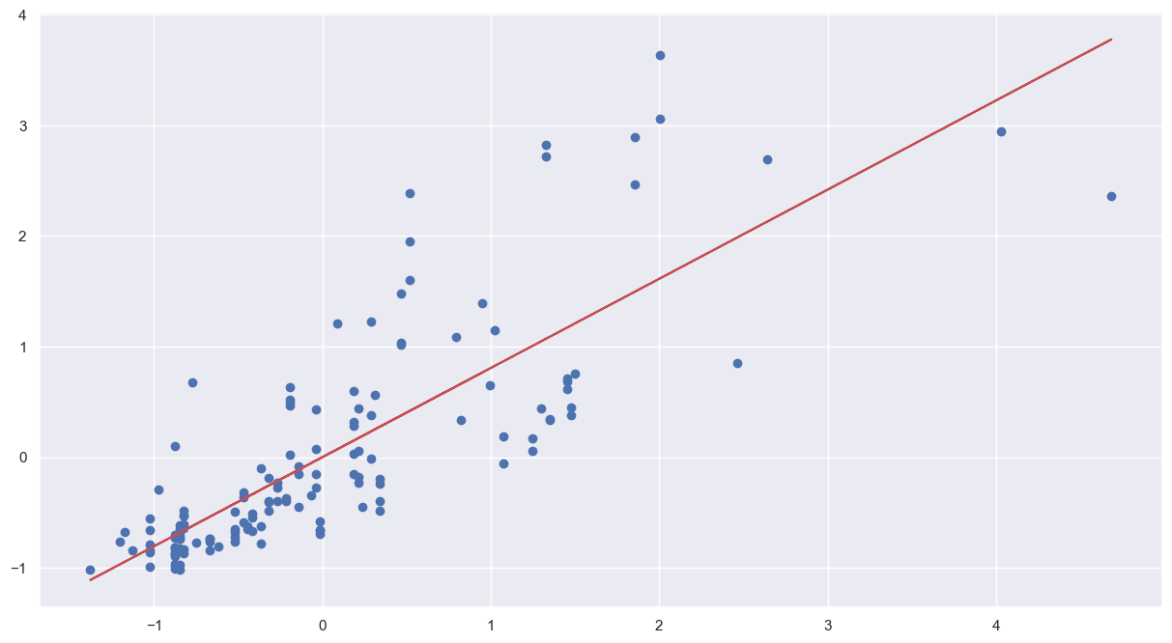
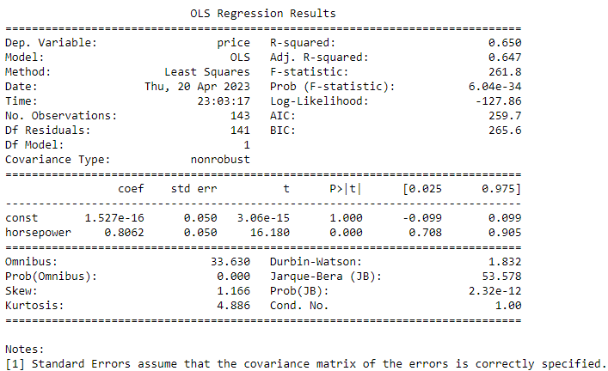
Scatter Plot and fitted regression line
Summary of the linear regression model obtained

Slide 22
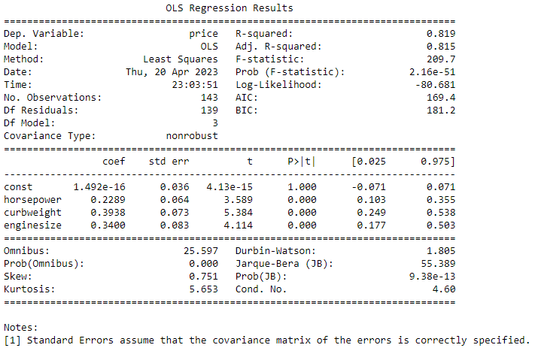
Adding Variables Curb Weight and Engine Size alongwith Horsepower
We have achieved a R-squared of 0.819 by manually picking the highly correlated variables. Now lets use RFE to select the independent variables which accurately predicts the dependent variable price.

Slide 23
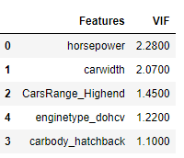
RFE - Recursive Feature Elimination
After passing the arbitrary selected columns by RFE we will manually evaluate each models p-value and VIF value. Unless we find the acceptable range for p-values and VIF we keep dropping the variables one at a time based on below criteria.
High p-value High VIF : Drop the variable
High p-value Low VIF or Low p-value High VIF: Drop the variable with high p-value first
Low p-value Low VIF : accept the variable
Dropped variables while updating the model through VIF and P-Values
Cylindernumber_six
Carbody_hardtop
enginetype_ohc
Cylindernumber_five
Enginetype_ohcv
Curb Weight
Cylindernumber_four
Carbody_wagon
carbody_sedan
Now the VIFs and p-values both are within an acceptable range. So we can go ahead and make our predictions using model lm_rfe10 and lm_rfe8

Slide 24
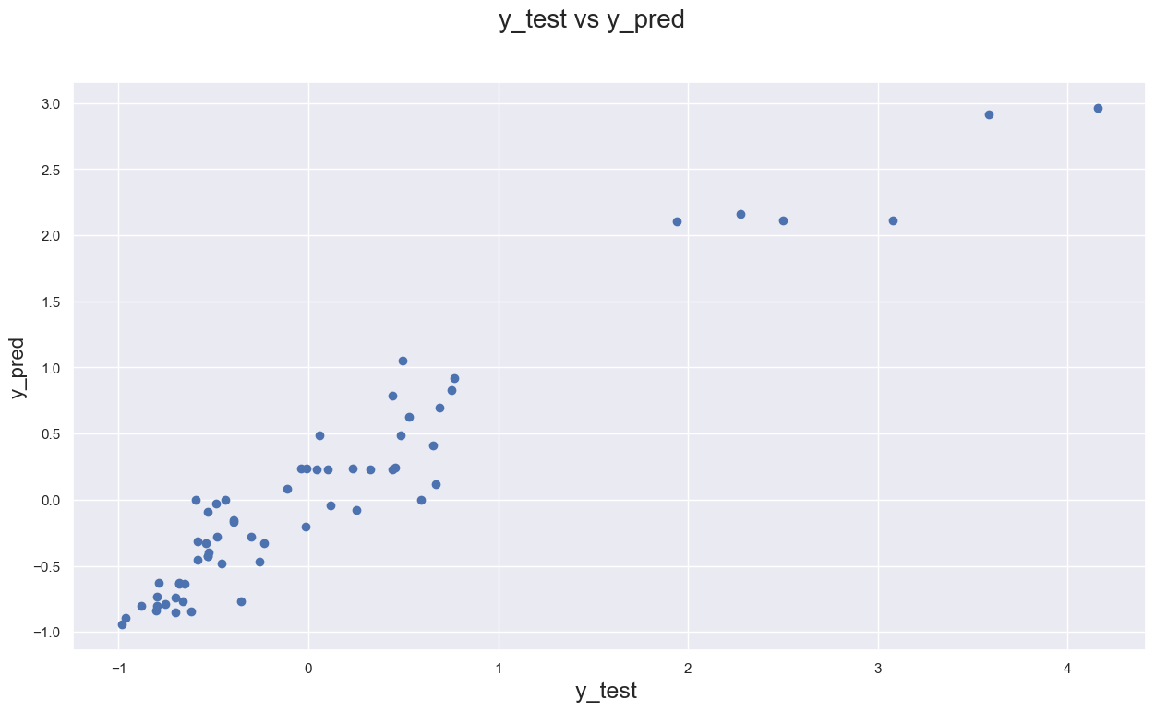
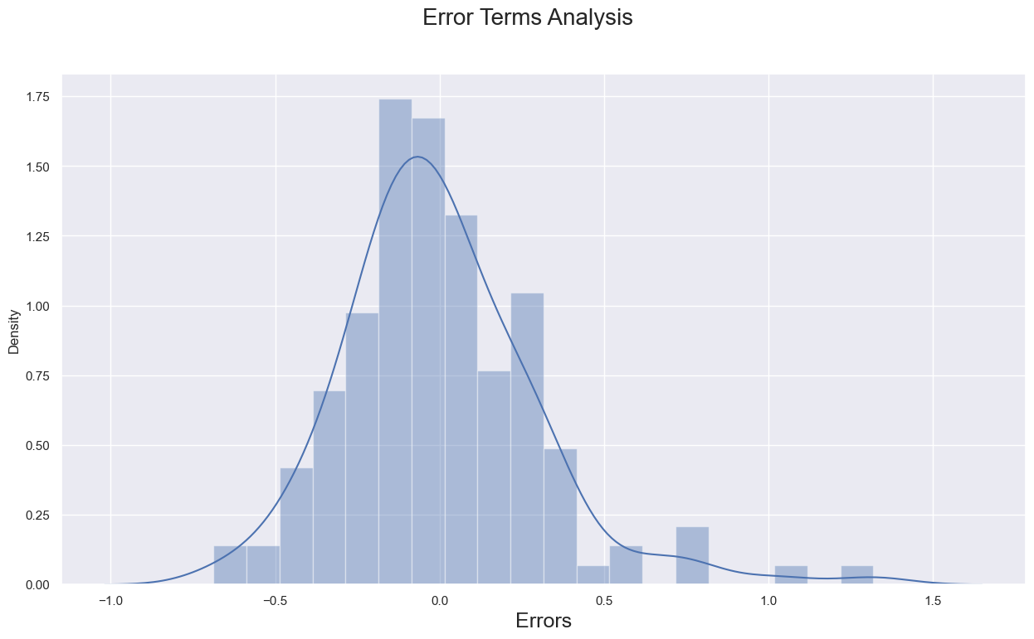
Model Evaluation (Model 1)
RMSE Score - 0.9094353587467603
The R2 score of Training set is 0.912 and Test set is 0.909 which is quite close. Hence, We can say that our model is good enough to predict the Car prices using below predictor variables
horsepower
car width
Cars_Category_TopNotch_Cars
carbody_hatchback
enginetype_dohcv

Slide 25

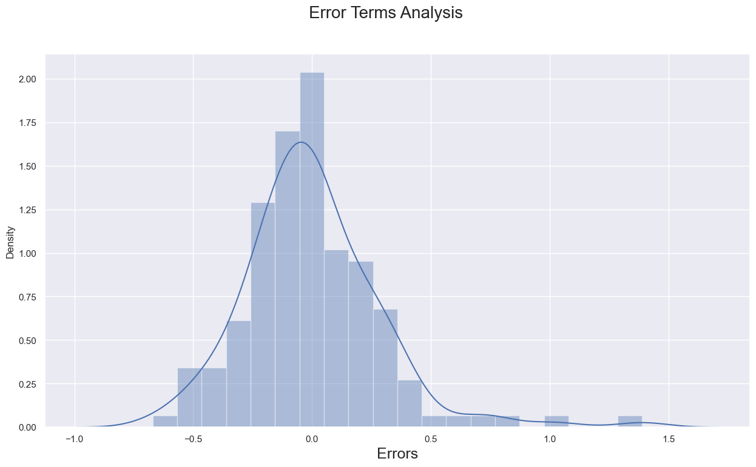
Model Evaluation (Model 2)
RMSE Score - 0.9153852894725919
The R2 score of Training set is 0.918 and Test set is 0.915 which is quite close. Hence, We can say that our model is good enough to predict the Car prices using below predictor variables
horsepower
car width
Cars_Category_TopNotch_Cars
carbody_hatchback
enginetype_dohcv
carbody_sedan
carbody_wagon

Slide 26

Conclusion
Both the models are good enough to predict the car prices which explains the variance of data upto 90% and the model is significant.
We saw the P value of train data is less than 0.05 indicating model is a good fit.
With 90% accuracy, So we can use this model for predicting price of a car in future.
While the model is good, it's the car brand name that sells more due to its recall factor and aspirations. Hence prices of certain cars are way higher as compared to their specifications.

Slide 27
Learnings from Project
Multiple linear regression is a useful technique for predicting the market value of cars based on various factors.
Data cleaning and exploration are crucial in ensuring the accuracy and reliability of the model.
The model can help buyers and sellers make informed decisions about the market value of cars.

Slide 28
Thank you!

